Slide 1
A Neural Network Approach For Supporting Gesture Keyboards in Augmented Reality
Junxiao Shen
Supervised by Professor Per Ola Kristensson
Engineering Department, Intelligent Interactive Systems Group
Notes:
my name is junxiao shen
my fourth year project is called a neural network approach for supporting gesture keyboards in augmented reality
I am supervised by professor per ola kristensson
I also thank john for his support through out my project

Slide 2
Background
Text Entry in Augmented Reality
Delimitation Problem
Hard for the sensor of current AR HMD to find the parallel to `touching' on a capacitive touchscreen
Correspondence Problem
Misalignment and delay between the actual finger and the measured virtual finger trace
Feedback Problem
Difficult to provide visual and haptic feedback
Data Sparseness Problem
No such gesture trace data available
Notes:
In augmented reality, there are many text entry methods. However, most of them face the following problems.

Slide 3
Project Overview
An AR Gesture Keyboard (ARGK) innovated from the word-gesture keyboard
Figure A: Illustration of a user typing on the gesture keyboard in AR, reproduced from Dudley et al. [1]
Figure B: Illustration of a user’s gesture trace
Notes:
To tackle the difficulties mentioned before, An ARE gesture keyboard innovated from the word-gesture keyboard is proposed. User can gesture on the virtual keyboard to input text in AR

Slide 4
Project Outline
ARGK with a Simulated Recogniser (with OptiTrack)
Phase 1: System Design & Data Collection (Completed)
Phase 2: Data Analysis (Completed)
ARGK with a Machine Learning Based Recogniser
Phase 1: Data Acquisition (On going)
Phase 2: Recogniser Design & Training (Future work)
Phase 3: Recogniser Assessment (Future work)
Notes:
The Project consists of two sub projects. The first subproject is my fourth year project which is to build a ARGK with a simulated recognizer. And I have completed it.The second subproject is to build a ARGK with a machine learning based recognizer. I am now working on the phase 1. This is because a large amount of data is required to train this machine learning based recognizer. Therefore, the simulated recognizer is to collect gesture trace data. Thus the data collected can not only be used to generate synthetic data to increase the dataset, but also be used to analyze the user behaviors through computing micro metrics.

Slide 5
Significance
Delimitation & Correspondence Problem
A machine learning-based recogniser is designed to be independent of the relative position between the gesture and the keyboard
Feedback Problem
The user receives feedback by simply looking at their actual fingertip
Entry Rate & Accuracy
This machine learning-based ARGK can account for cognitive-motor errors manifesting as misspellings or similar traces
Data Acquisition
We will build an ARGK with a simulated recogniser so that we can collect the trace data in the user experiments.

Slide 6
Results
Simulated Text Entry Rate
The simulated entry rate indicates the true entry rate that can be potentially achieved by the completed ARGK
Micro Metrics
To analyse the gesture trace data collected from user experiments
Provide us with a rigorous user behavioural result
Be compared with the micro metrics obtained from the synthetic data for quality check purpose
Notes:
We analyze the data quantitatively. The first quantity is the simulated text entry rate as it reflects well of the potential entry rate which can be achieved by the machine learning based recognizer. Then we proposed several micro metrics. The micro metrics is important not only in the user behavioral analysis but also in the quality check for the synthetic data.

Slide 7
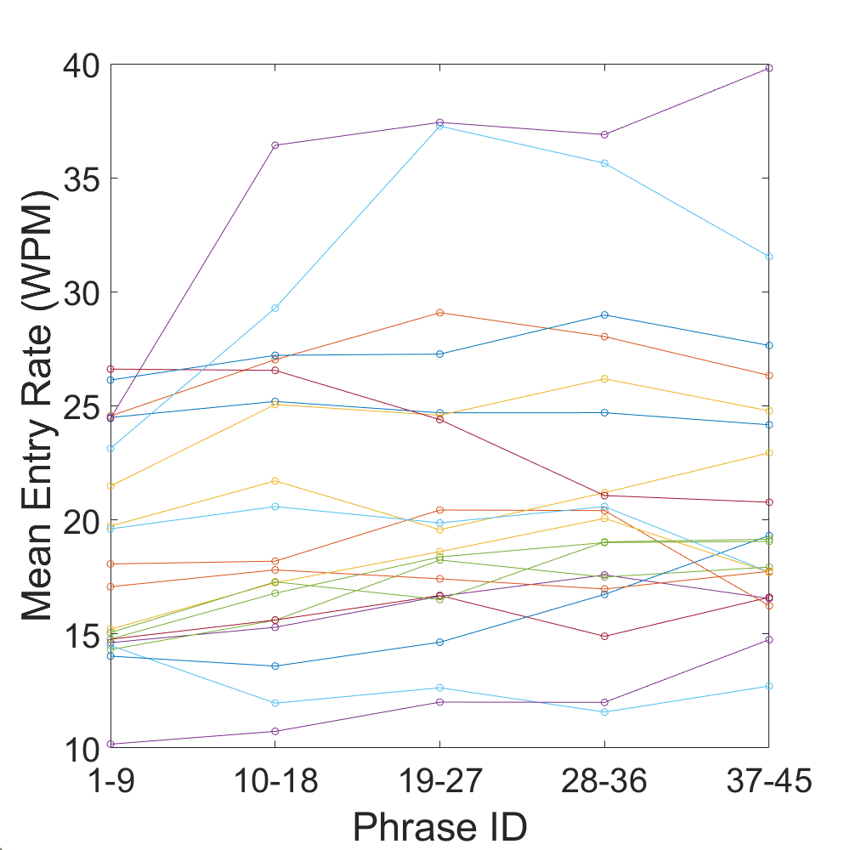
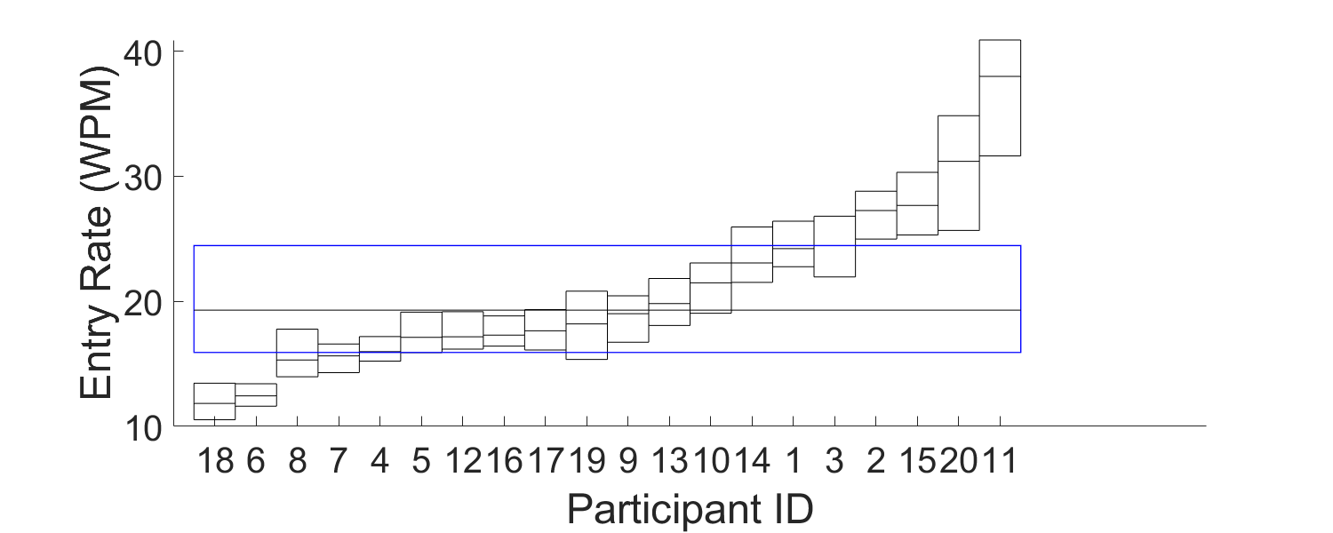
Simulated Text Entry Rate
Figure A: Text entry rate (WPM) over the experiment
for different participants
Figure B: Median and interquartile range
for the text entry rates for each participant and across all the participants
Notes:
Figure A shows that the user tends to gesture faster over the experiment, Figure B shows that there are two subsets of participants who can gesture really fast and who has a slow gesture speed, respectively. However, most of the participants lie within the 16 to 24 WPM interquartile range. Therefore, it shows the potential of the ARGK to beat most of the state-of-the-art text entry methods in AR.

Slide 8
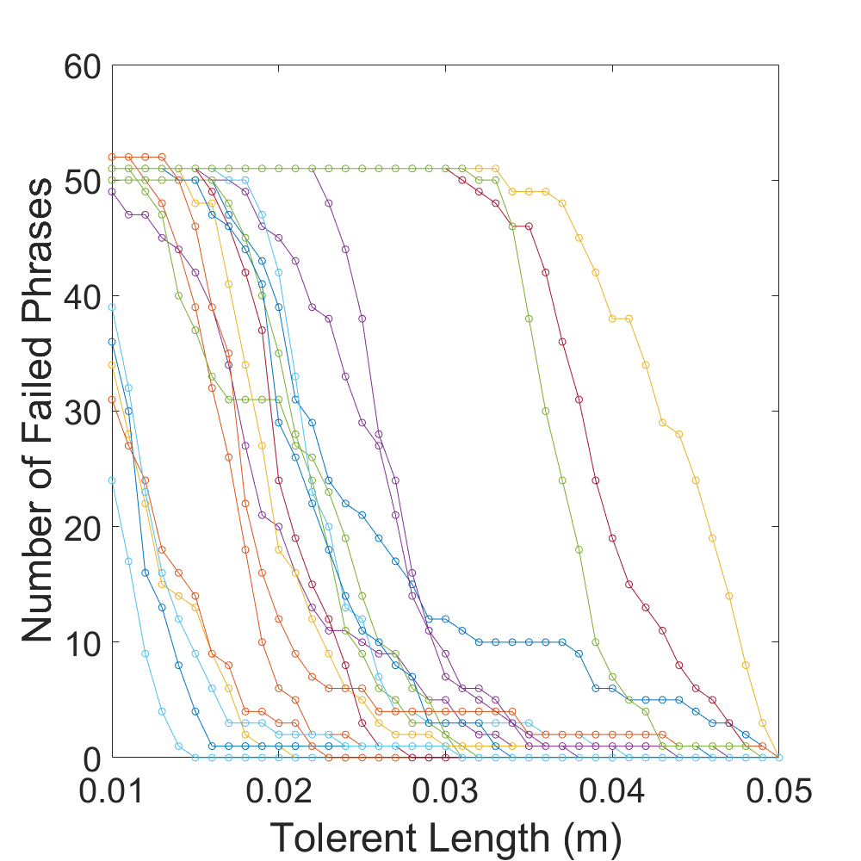
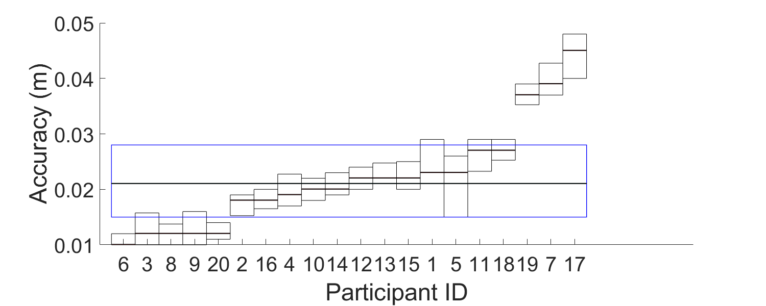
Micro Metric - Gesture Accuracy
Figure B: Median and interquartile range
for the accuracy for each participants and across all the participants
Figure A: Number of failed phrases against the tolerant length
Notes:
Figure A shows that Most participants show a decreasing gradient in the middle of the curve, and this suggests that they have achieved good accuracy.
Figure B shows that most participants show a decreasing gradient in the middle of the curve, and this suggests that they have achieved good accuracy.

Slide 9
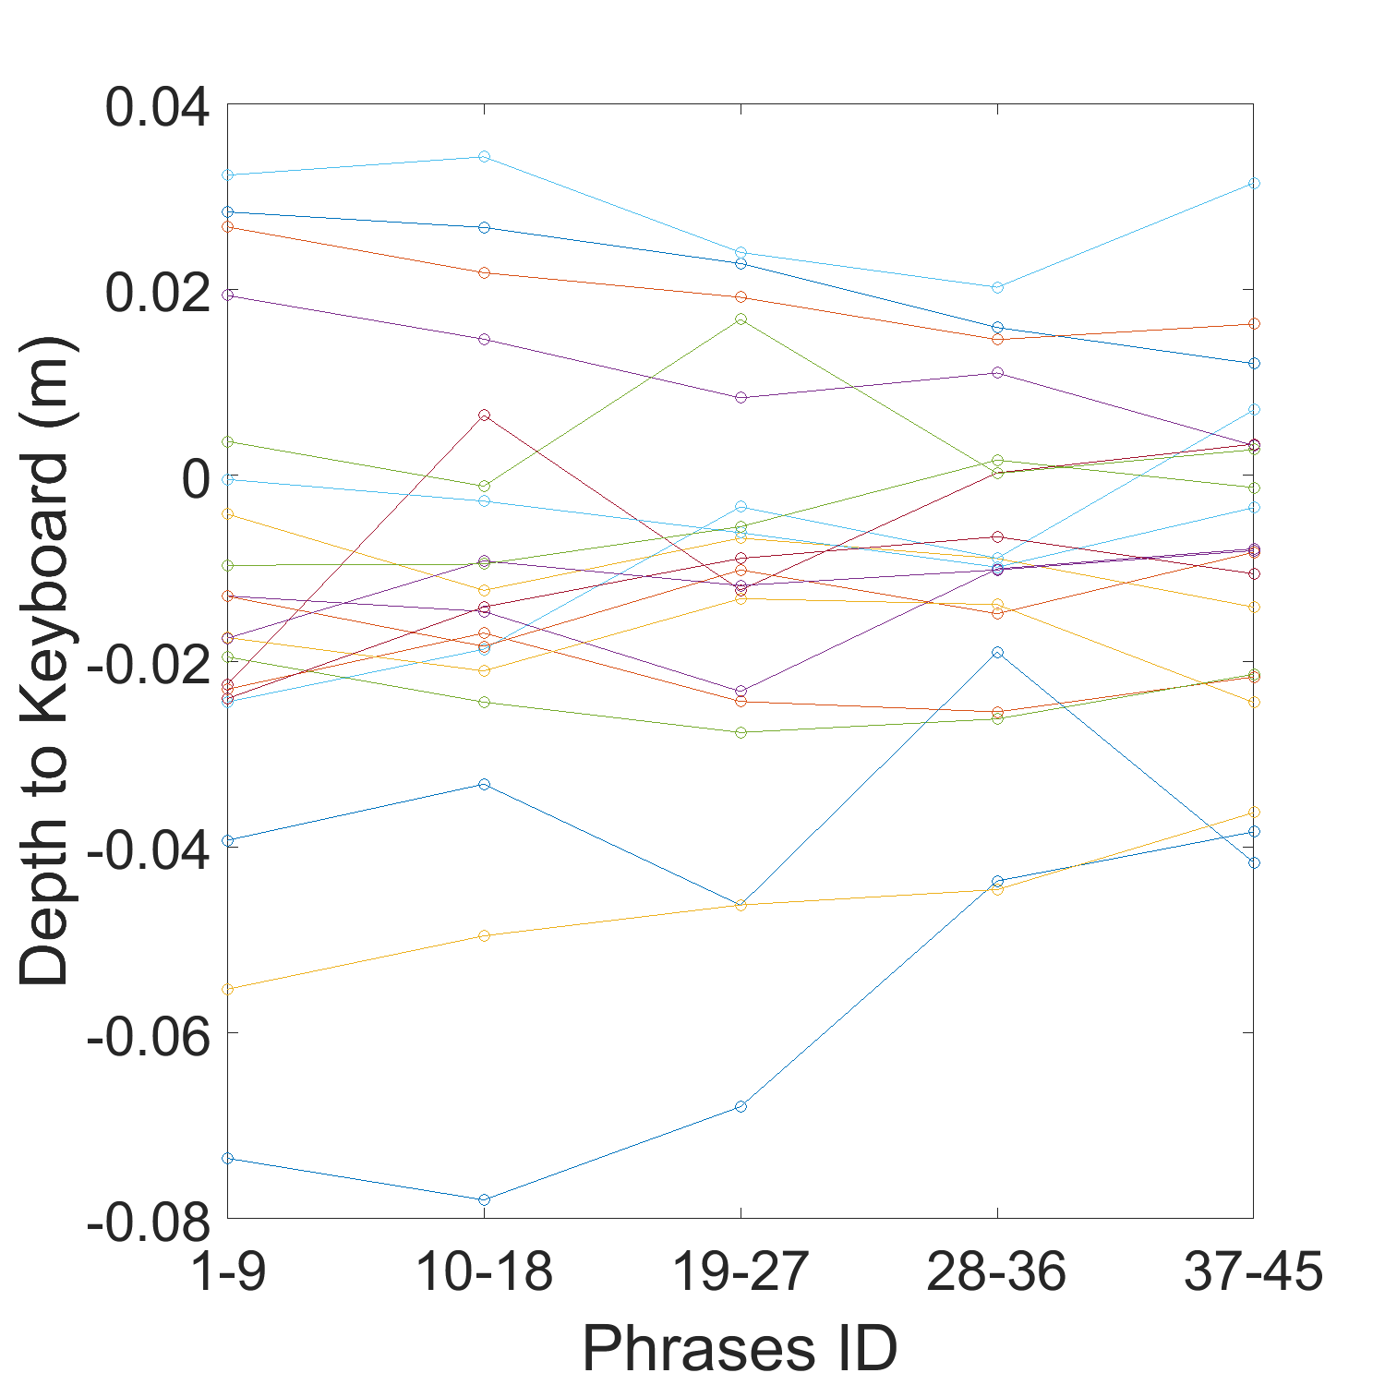
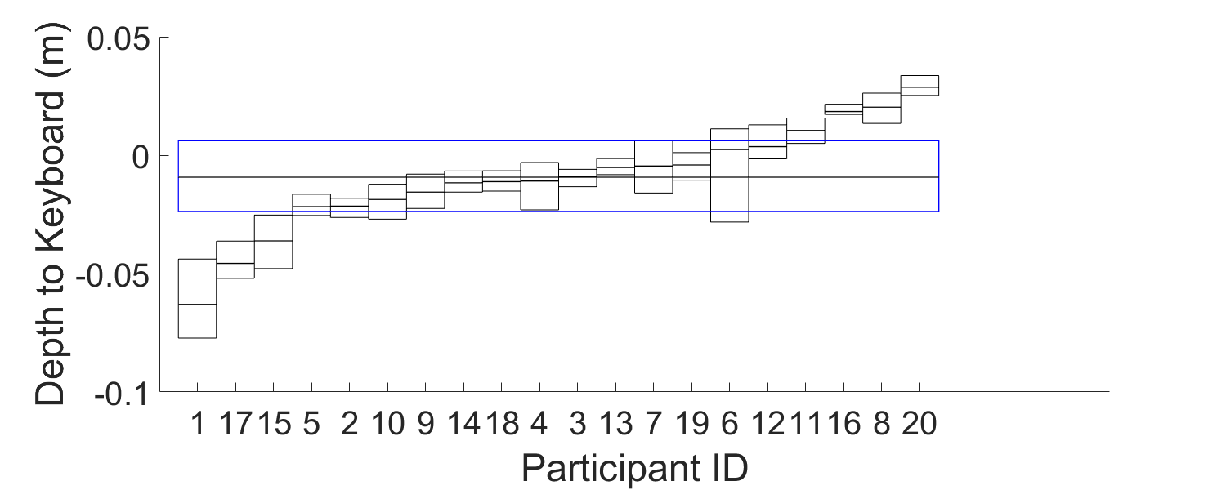
Micro Metric - Depth Consistency
Figure A: Depth to the keyboard over the experiment
Figure B: Median and interquartile range
for the depth for each participant and across all the participants
Notes:
Gesture Consistency is an important metric that analyses the user’s perception of the virtual keyboard. Different user may have a different depth perception of the virtual keyboard shown in the HoloLens. Therefore, the depths of the keyboard perceived by different users are very different and the traces they gesture fit into planes with a variety of displacement and rotation angles from the virtual keyboard.
Figure A shows that participants tend to gesture away from the keyboard as the experiment goes on since they tend to relax over the experiment. Therefore, the depth difference is larger at the end of the experiment.Figure B shows that most people will tend to gesture in front of the keyboard instead of right on it or behind it.

Slide 10
Micro Metric - Depth Consistency
Beta Angle
The angle between the normal vector and the Z-axis in the Z-Y plane
Theta Angle
The angle between the normal vector to the plane and the Z-axis in the Z-X plane
RMSE
The root mean square error between the trace data points and the plane that they fit into
Notes:
As discussed above, we assumed that the user may have a different perception of the key- board position and orientation. Therefore, the keyboard plane perceived by the user may not be aligned with the actual virtual keyboard plane. This results in an angle and a displacement between the plane that the user draw gesture on and the actual keyboard plane. This micro metrics can tell us how good the user is at perceiving the relative position and orientation of the virtual keyboard.

Slide 11
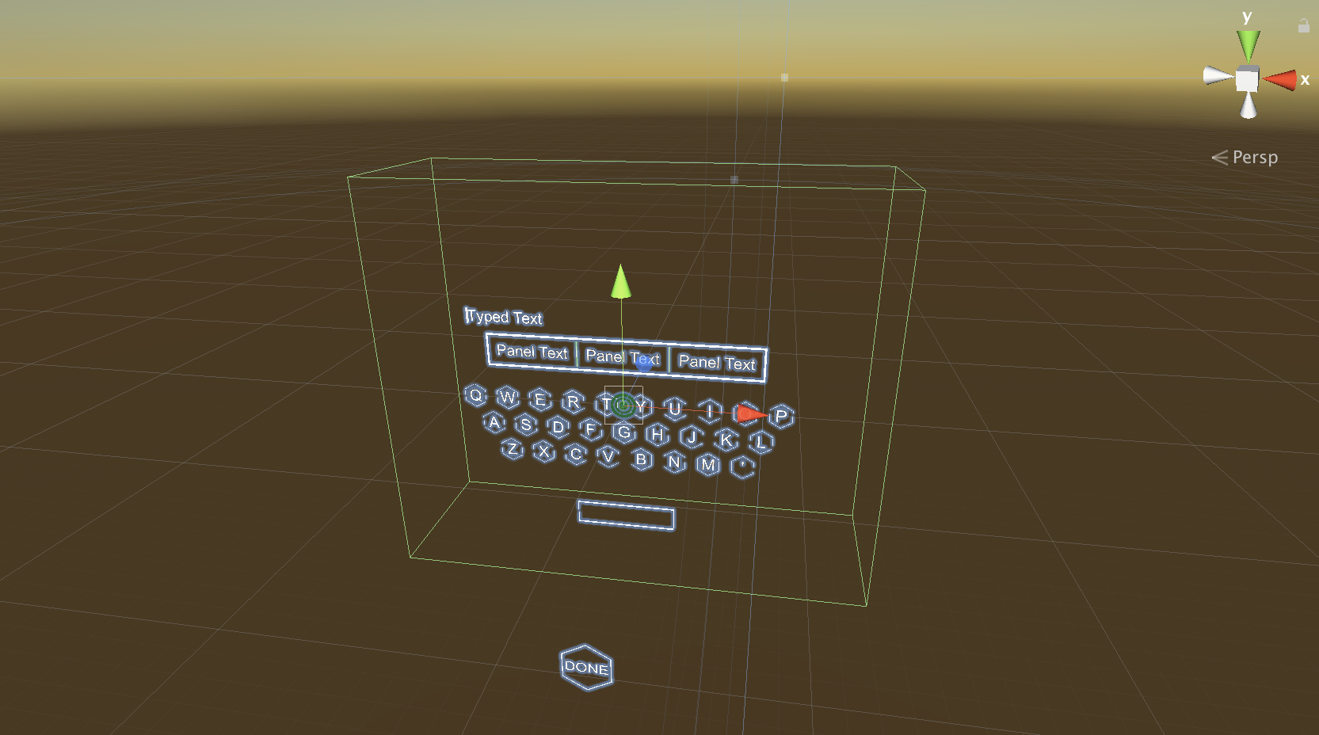
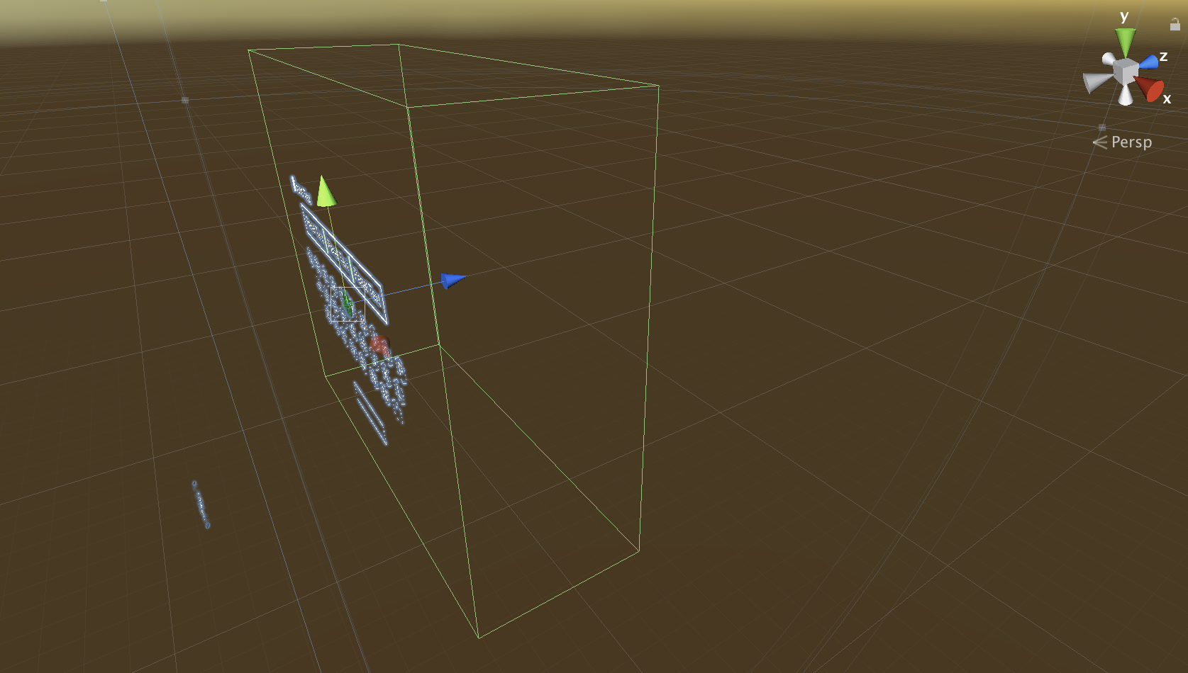
Micro Metric - Depth Consistency
Figure: A view of the virtual keyboard to show the X-Y-Z coordinates and orientation

Slide 12
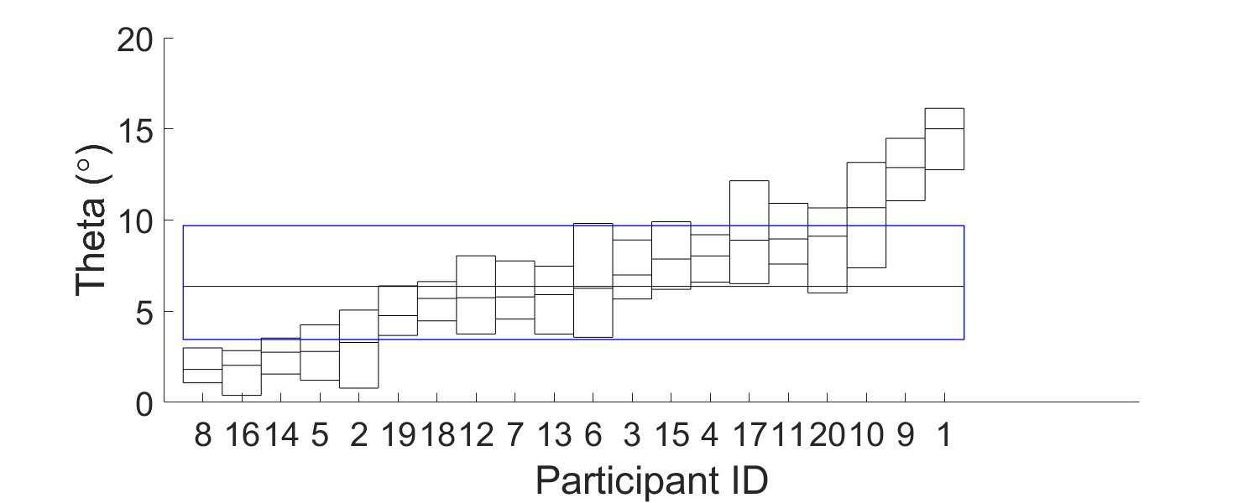
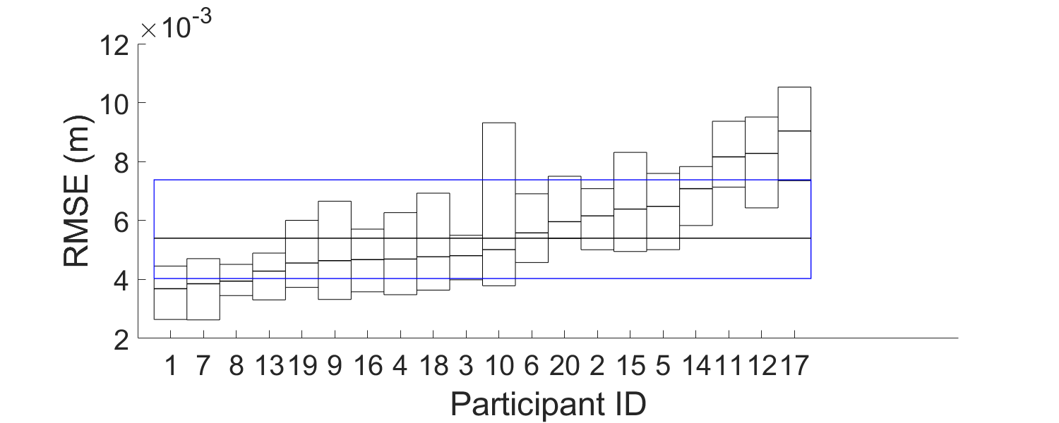
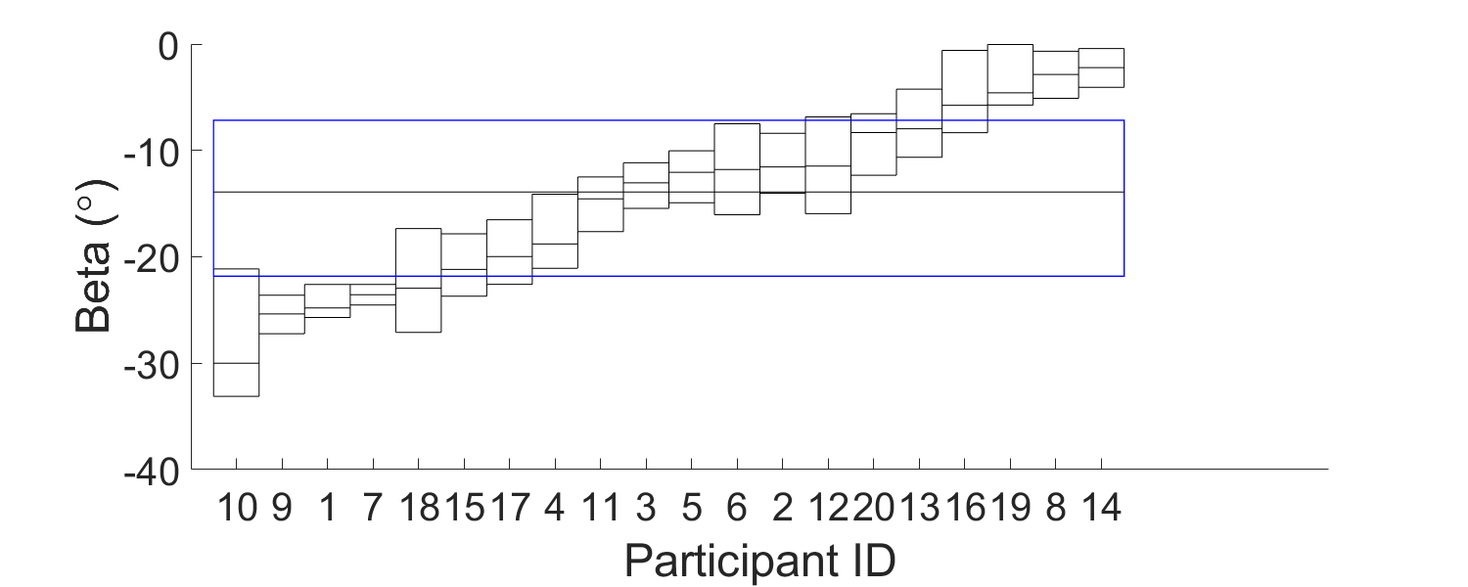
Micro Metric - Depth Consistency
Figure: Median and interquartile range for the Theta, Beta and RMSE for each participants and across all the participants
Notes:
Theta angle plot shows that the mean is around 7 degrees and it suggests that
The median of the beta value is around –12 degrees which is expected since the user will tend to gesture on a plane vertically in front of them whereas the keyboard float at an angle
The RMSE value shows that the trace data closely fit into that plane and it suggest that user are consistent at gesturing

Slide 13
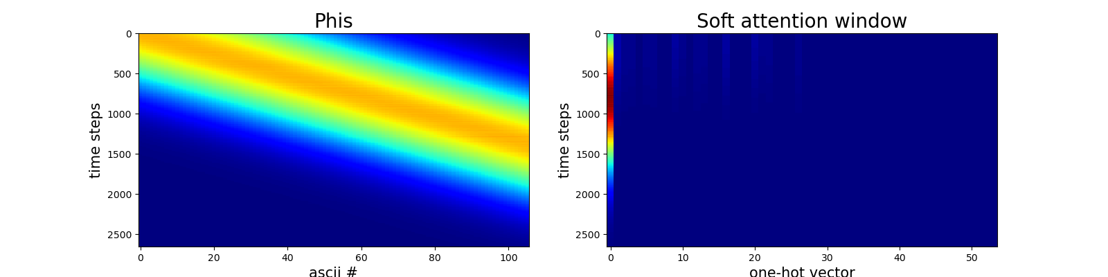
Data Synthesis Results
Figure 25: Plots for the phrase ‘this should be okay’. Plots on the right and left are the time series plots of the soft window’s position from the generated trace correspond to the phrase. However, they have different horizontal axes. The horizontal axis in the right plot is what the model sees when it looks through the soft window. The horizontal axis is the one-hot vectors. The first one-hot vector is _ and the next one-hot vector is a and so on as shown on the up- per horizontal axis. The horizontal axis in the left plot is the sequence of ASCII characters that the model is drawing. The colour represents a heat map that shows the magnitude of the time series.
Notes:
This part of results are from the data synthesis. I constructed a recurrent neural network consists of three LSTM layers and one attention mechanism. I used the collected data to train this neural network and applied different training techniques such as dropout, batch training and learning rate scheduler. The two plot shows the results I have achieved. Let me explain the two plots first. The two plots are both shows the soft attention window which is the output of the trace after the convolution.

Slide 14
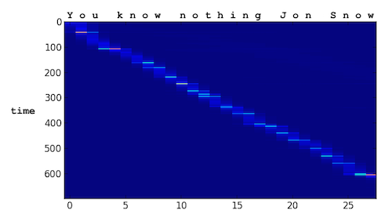
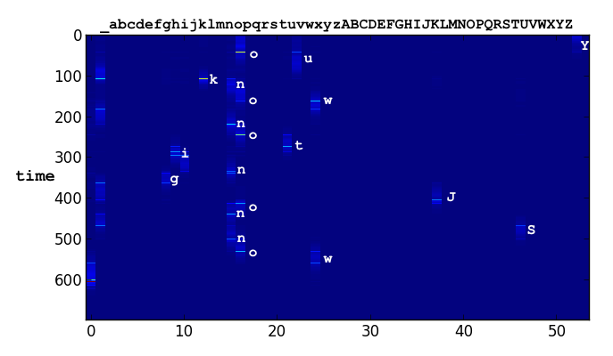
Data Synthesis Results
Figure A
Figure B

Slide 15
Discussion
Limitations
This ARGK requires sufficient space before the users
Similar to the word-gesture keyboard in mobile phones, this ARGK is unable to output or predict unseen word or phrases such as a password
We have used OptiTrack to track the fingertip of the user since the sensor in the HoloLens 1 has a large latency and offset
Future Work
Working on training the neural network to achieve acceptable results
Another neural network needs to be constructed and trained to map the combined data set consists of both synthetic and real data to the corresponding phrases
Another user experiments will be carried out to assess the full ARGK with this machine learning-based recogniser
Notes:
Despite of the advantages of the ARGK, this ARGK also has its own limitations.
The future work includes.

Slide 16
Conclusions
The simulated recogniser shows the potential of machine learning-based recogniser by using different micro metrics
The simulated recogniser enabled us to collect representative gesture traces from the user experiments
The machine learning-based ARGK shows great potential in beating the state of art text entry methods in AR in terms of gesture speed and user experience
Notes:
In conclusion, the significance of my fourth year project which is the simulated recogniser includes

Slide 17
Thank You！
Q&A

